Slide 1
LIVE | Educational Video Game Database
Zachary McDowell, Xiuyu Tang, Yeon Chae, Nilo Lisboa, Komo Zhang
CSCE 606 - Spring 2024

Slide 2
Agenda
Project Overview
Design
Architecture
Development
Functionality
Challenges
Live Demo

Slide 3
Project Overview

Slide 4

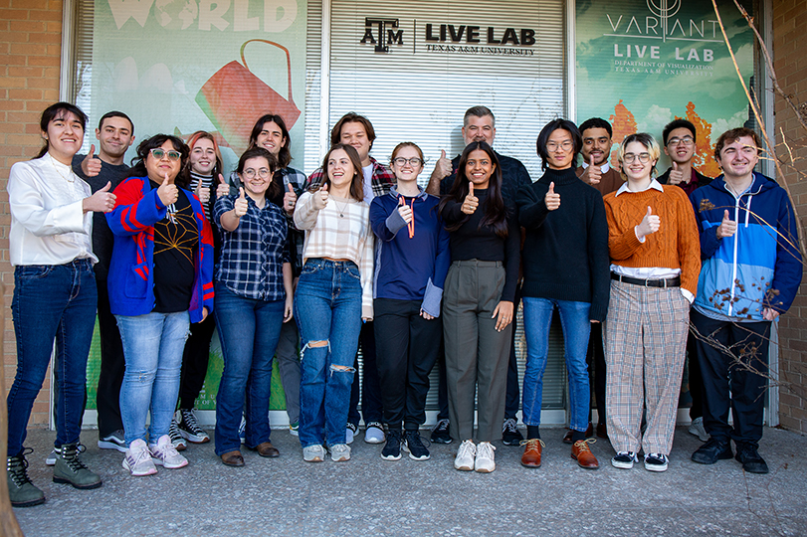


Project Overview
LEARNING
INTERACTIVE
VISUALIZATION
EXPERIENCE
Dr. Michael Rugh
Email: michael.rugh@tamu.edu
Notes:
The LIVE Lab is a research lab at Texas A&M University in the School of Performance, Visualization and Fine Arts where students learn to create interactive learning experiences while getting real industry experience. With the help of subject matter experts and instructional designers, students collaborate to make high-quality digital learning experiences, touching on every aspect of professional development including design, concept art, 3D modeling, development and management.

Slide 5
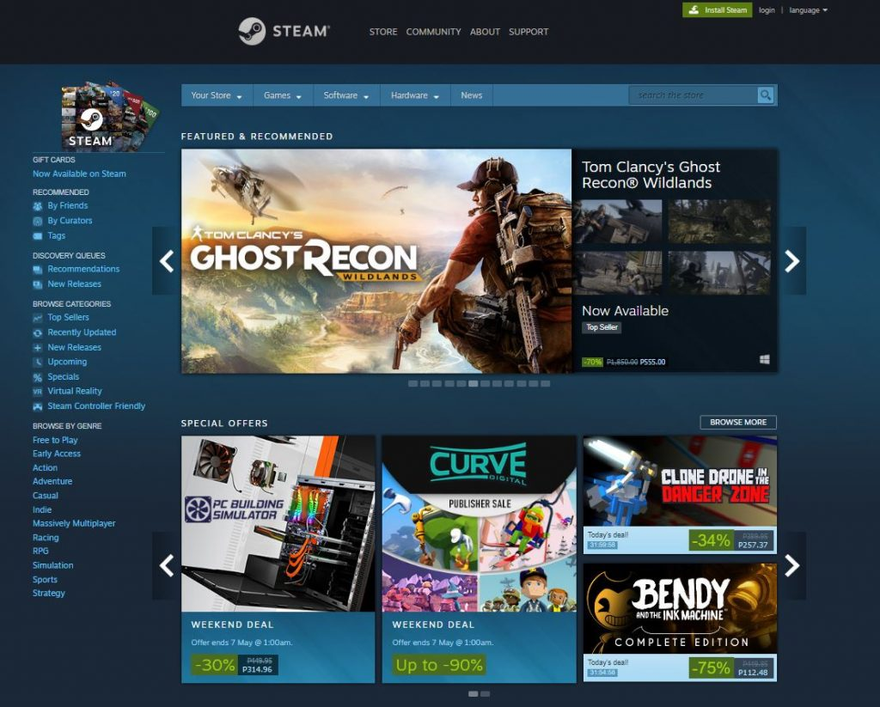
Project Overview
Cloud-based database of Education Video Games (EVG’s)
Intended for teachers, faculty, administrators, and students

Slide 6
Design

Slide 7
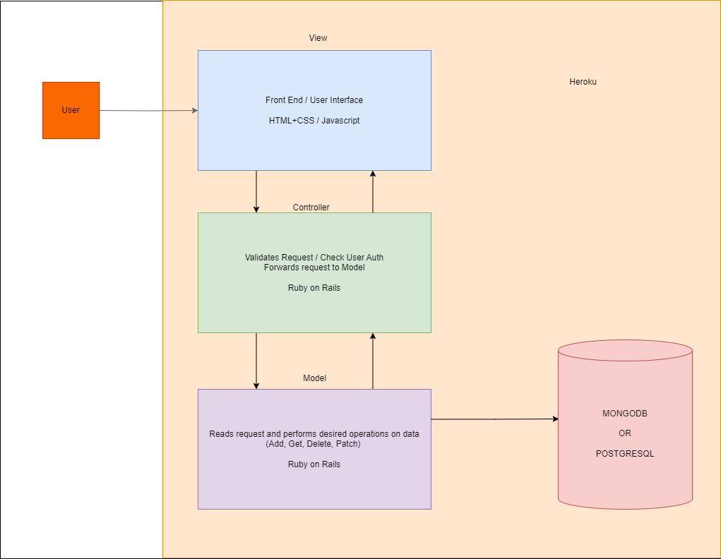
Design: Architecture
Notes:
Utilizing MVC

Slide 8



Design: Development
Development Framework: Ruby on Rails
Deployment Platform: Heroku
Database: PostgreSQL

Slide 9
Functionality

Slide 10
Functionality
User Account | Game View | Game Management
Account creation Sign-in/Sign-out User/Moderator/Admin User management Password control | Featured games Sorting Filtering Searchable Display details Images and Videos | Create new game Edit Delete Game linkage
Notes:
Utilizing MVC

Slide 11


Functionality: User Account
Users: General “visitor” privilege
Moderator: User privilege and game management
Admin: Everything but the code itself
Notes:
Utilizing MVC

Slide 12
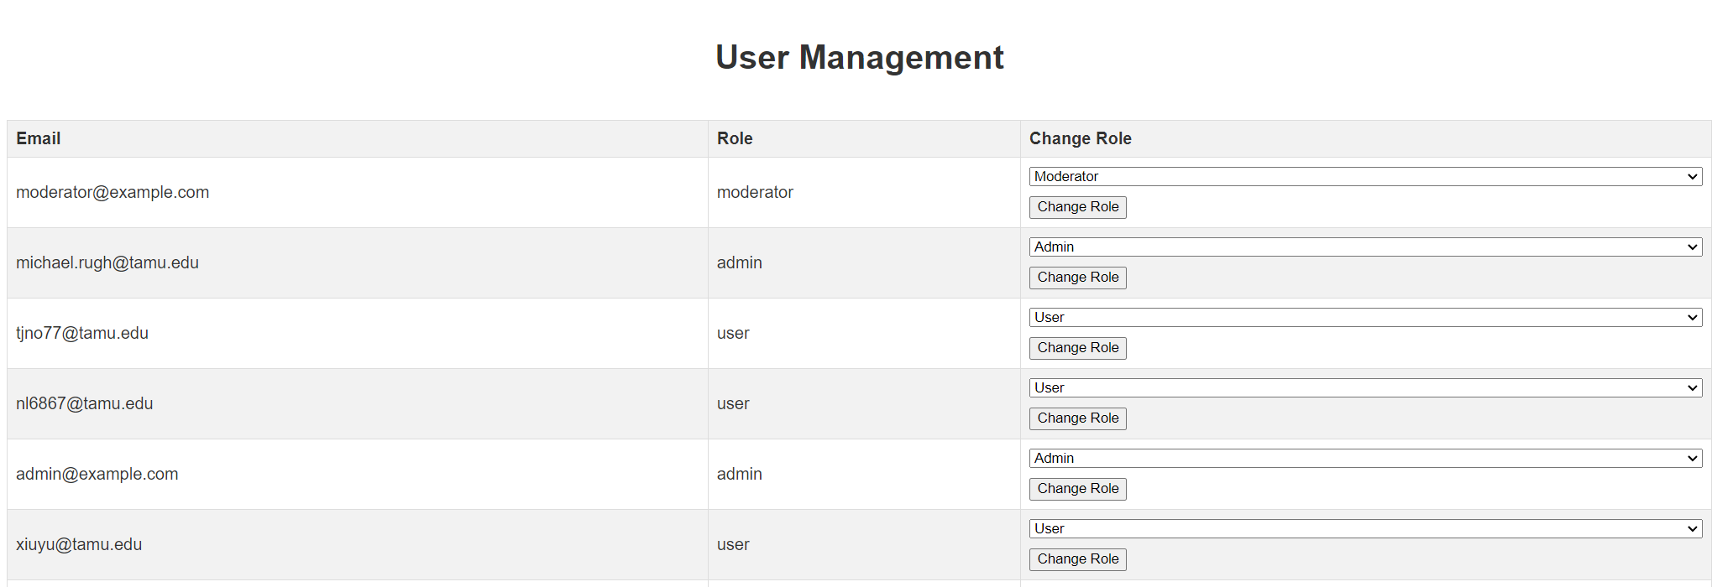
Functionality: User Account
Notes:
Utilizing MVC

Slide 13
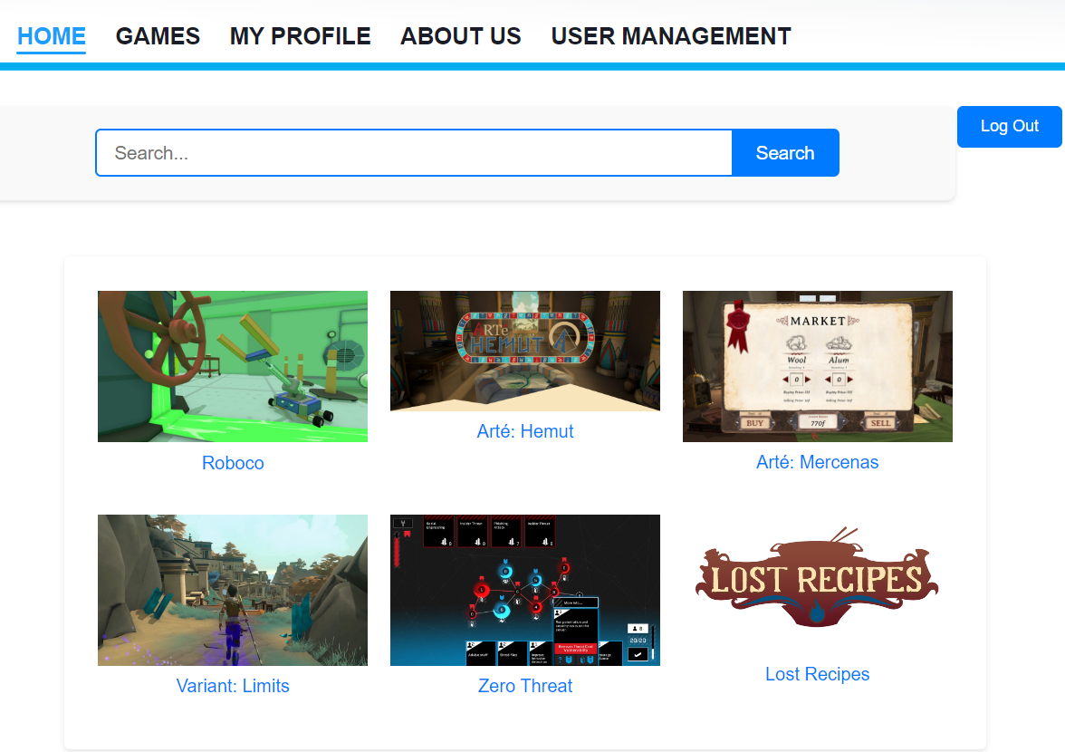
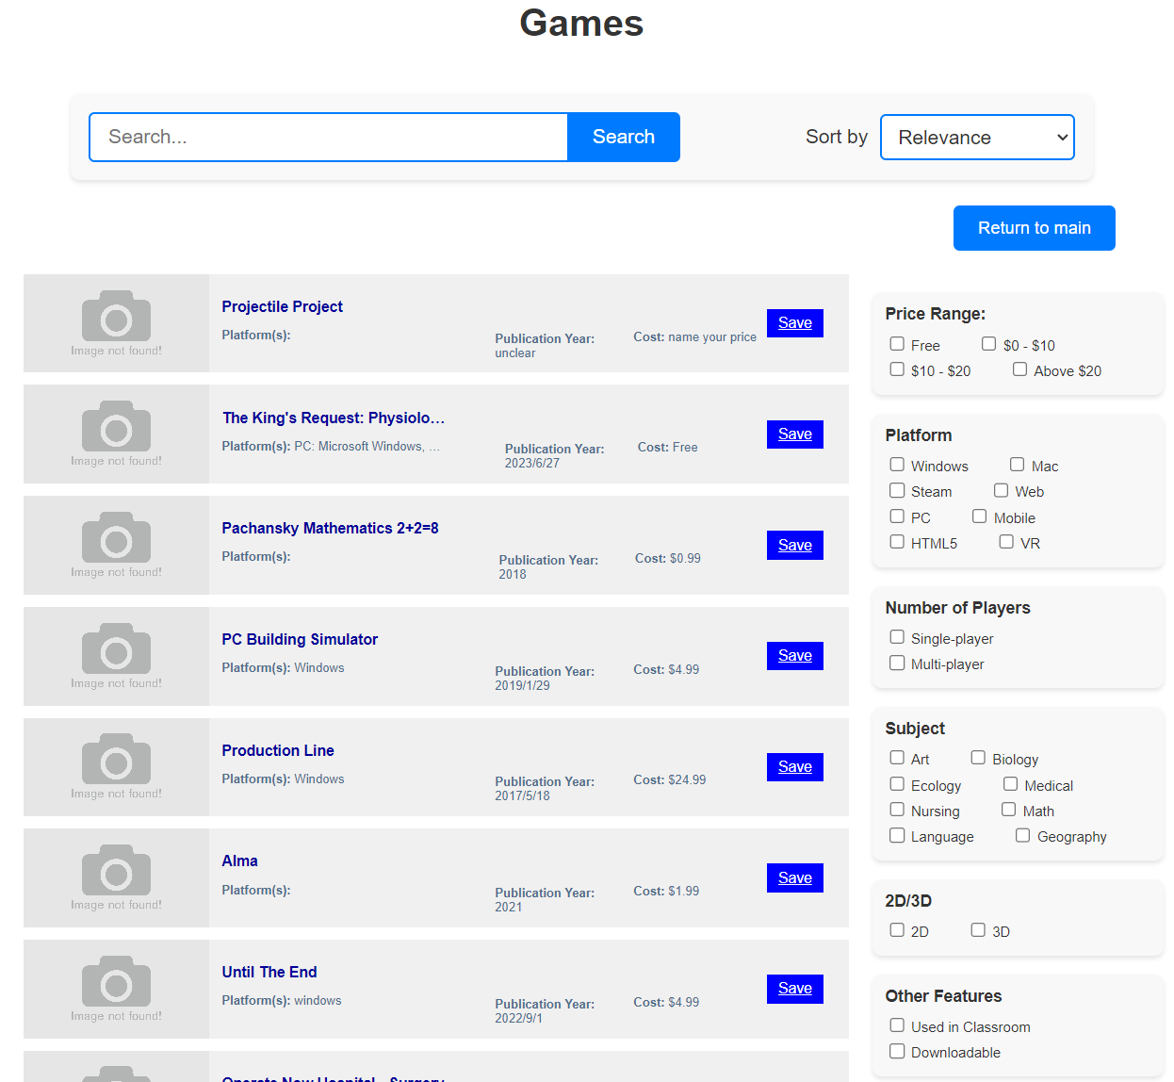
Functionality: Game View
Notes:
Utilizing MVC

Slide 14
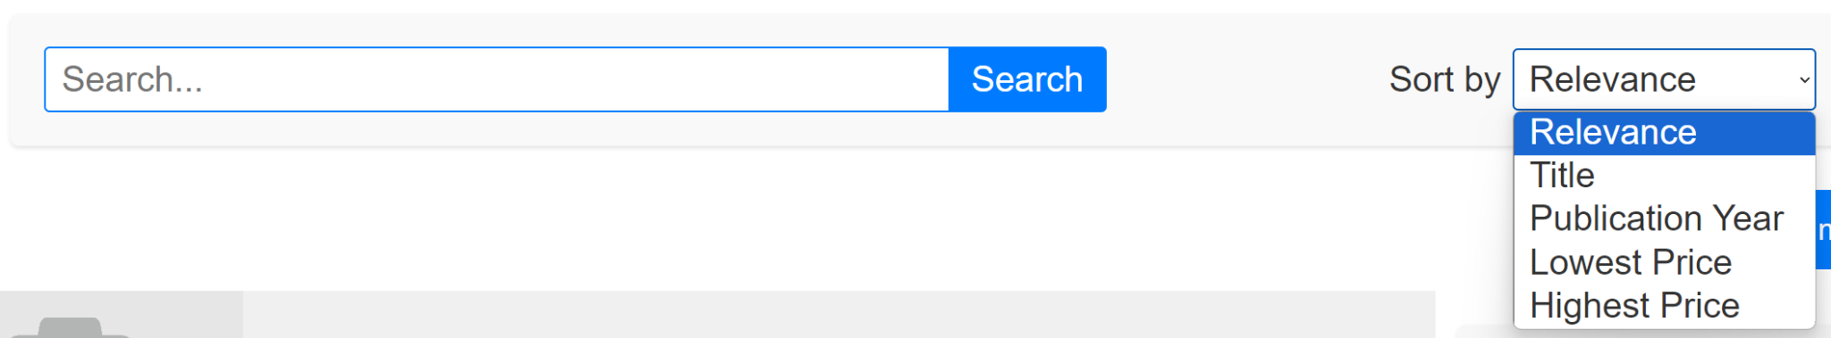
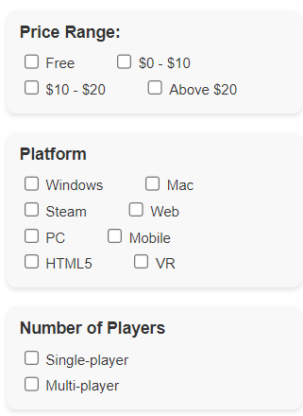
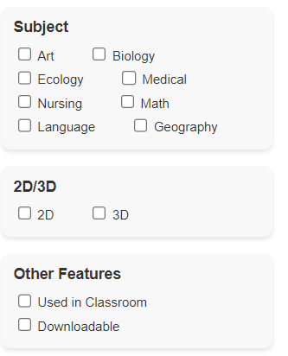
Functionality: Game View
Notes:
Utilizing MVC

Slide 15
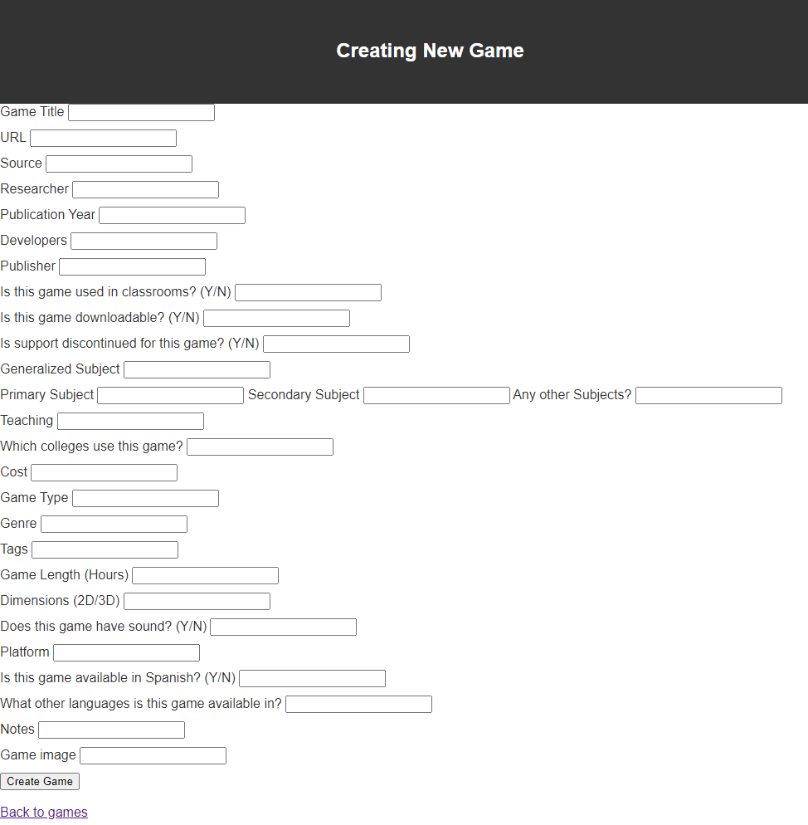

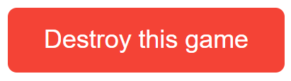
Functionality: Game Management
Notes:
Utilizing MVC

Slide 16
Challenges

Slide 17

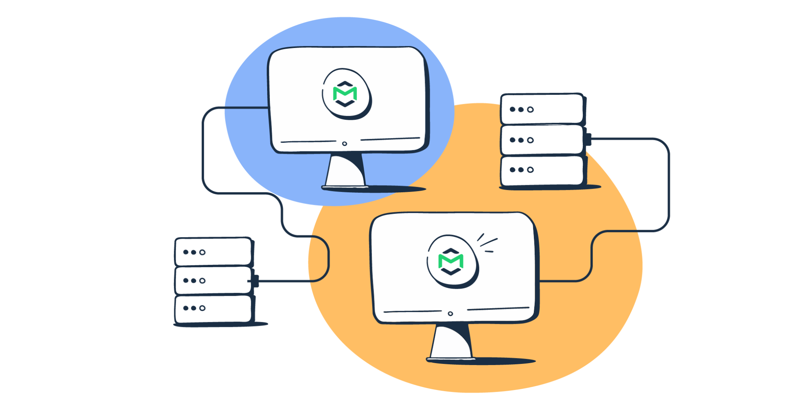
Challenges: Forgot Password
Forgot password email
Simple Mail Transfer Protocol (SMTP) with new Gmail account
Notes:
Utilizing MVC

Slide 18
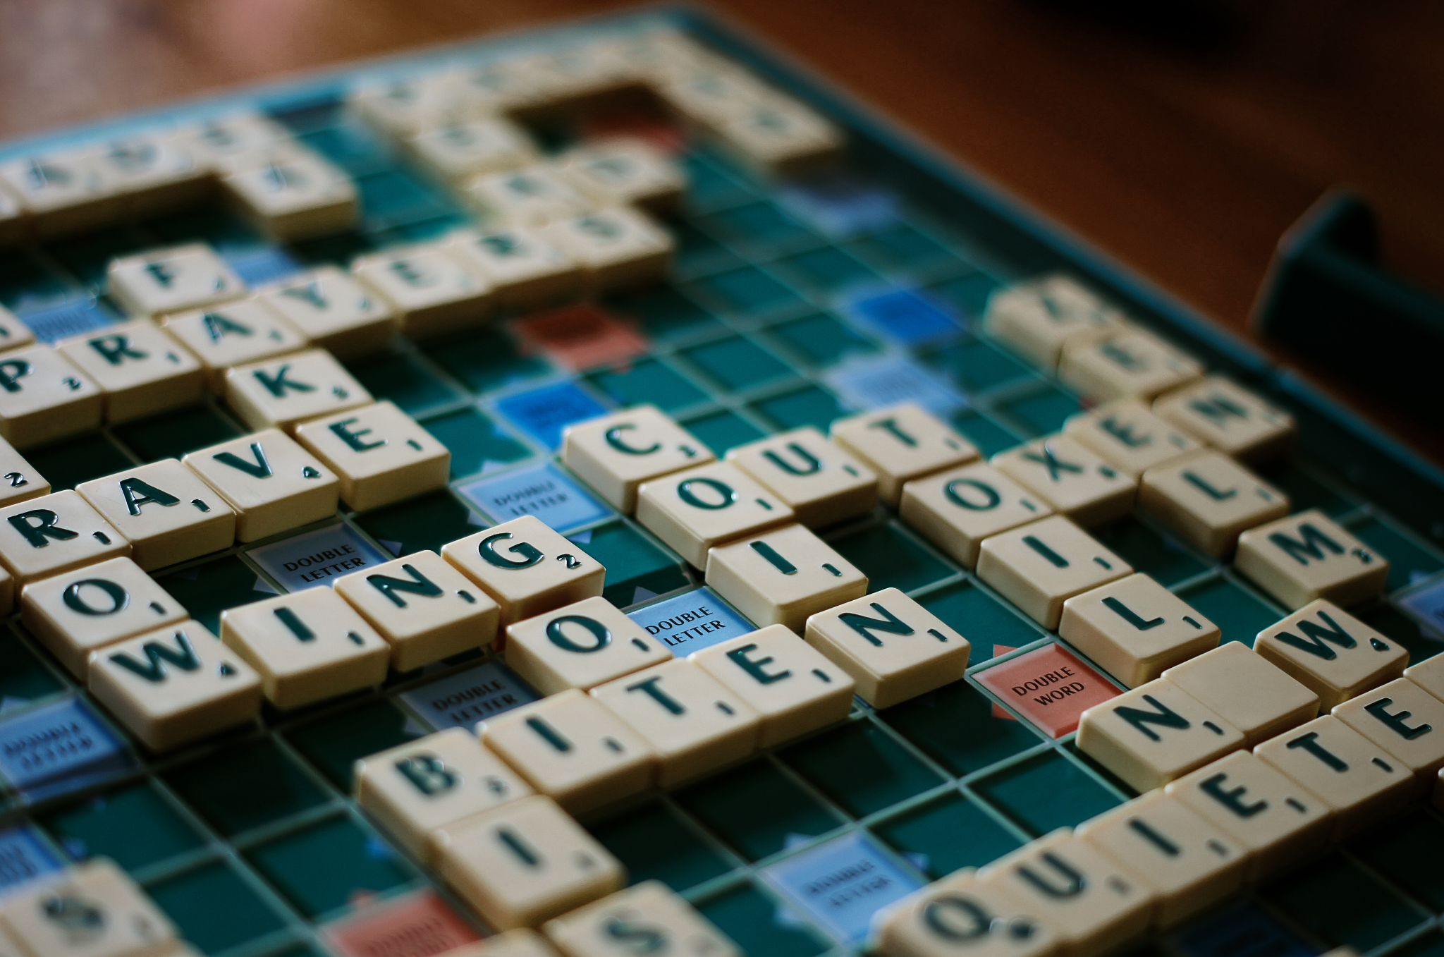
Challenges: Vague Search
Vague search bar
Find games with similar spelling or common misspelling
Notes:
Utilizing MVC

Slide 19
Live Demo

Slide 20
“Thanks & Gig’em!”

